Slide 1
Design
Chris, Quynh, Gavin

Slide 2
Note
Fundamental to the project
Properties:
id: String (identifier for the note)
frequency: int
octave

Slide 3
Tuner feature
Include 2 classes:
Tuner & Instrument
Tuner is for tuning
Instrument includes tuning options for particular instruments

Slide 4
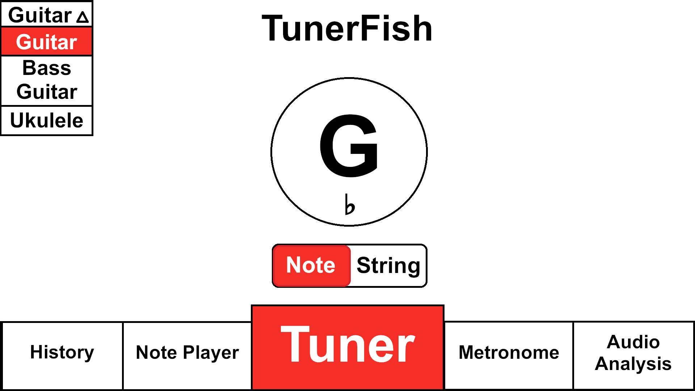
Visual Desing

Slide 5
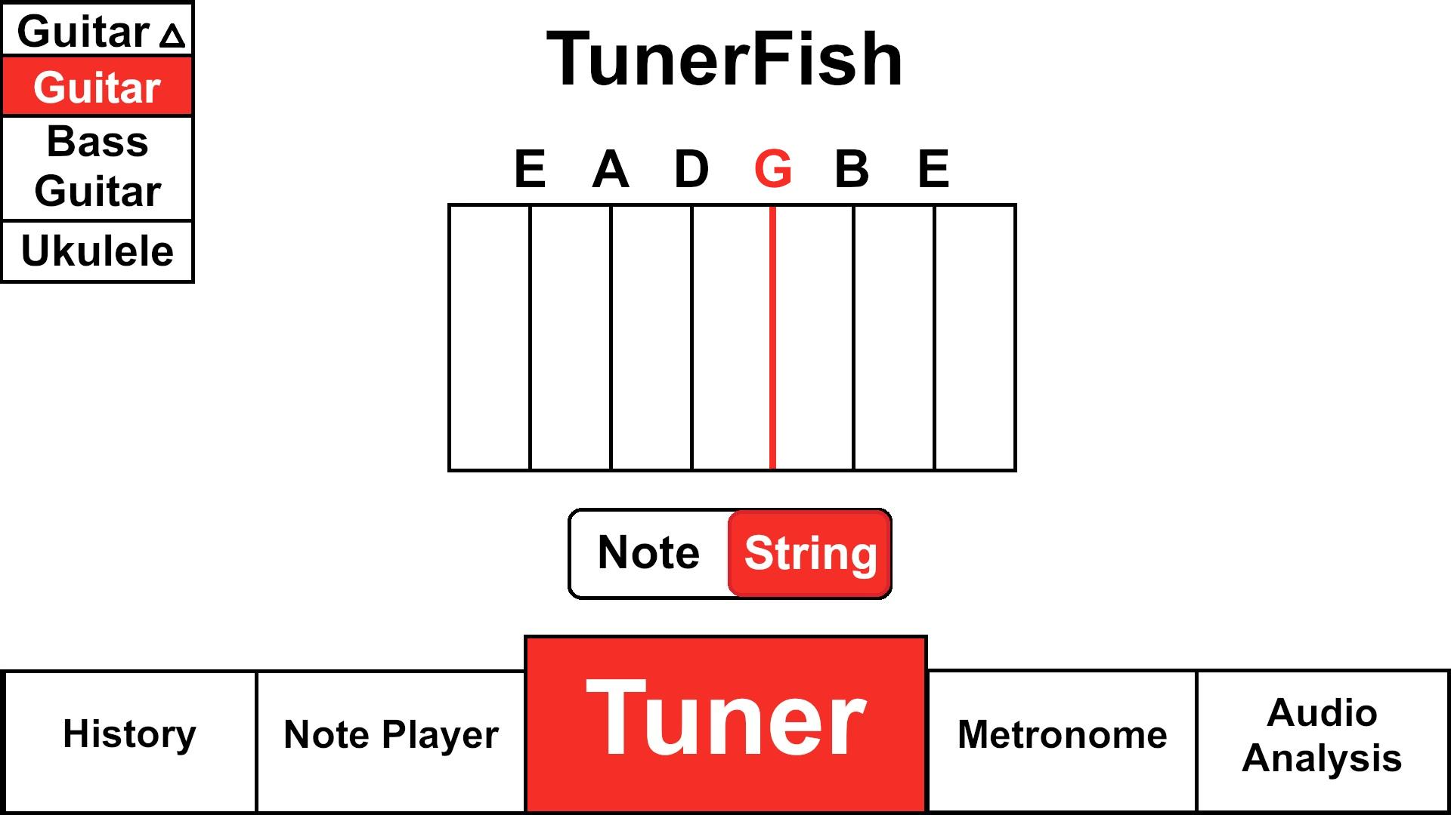

Slide 6
Instrument Class
Properties:
id: int
name: string
num_strings: int
insturment_strings: List<Note>
presetTunings: List<Note>
Methods:
setInstString(Note)

Slide 7
Tuner Class
Inherited from Instrument and Note class
Properties:
soundSample: List<float>
cents: int (which cents is the note in?)
pitchCorrectness: float (how correct is the pitch?)
pitch_table: List<Note>
instrument_list: List<instrument>
temperment: float

Slide 8
Metronome feature
Metronome class:
properties:
tempo: float
beat: int
isPlaying: bool

Slide 9
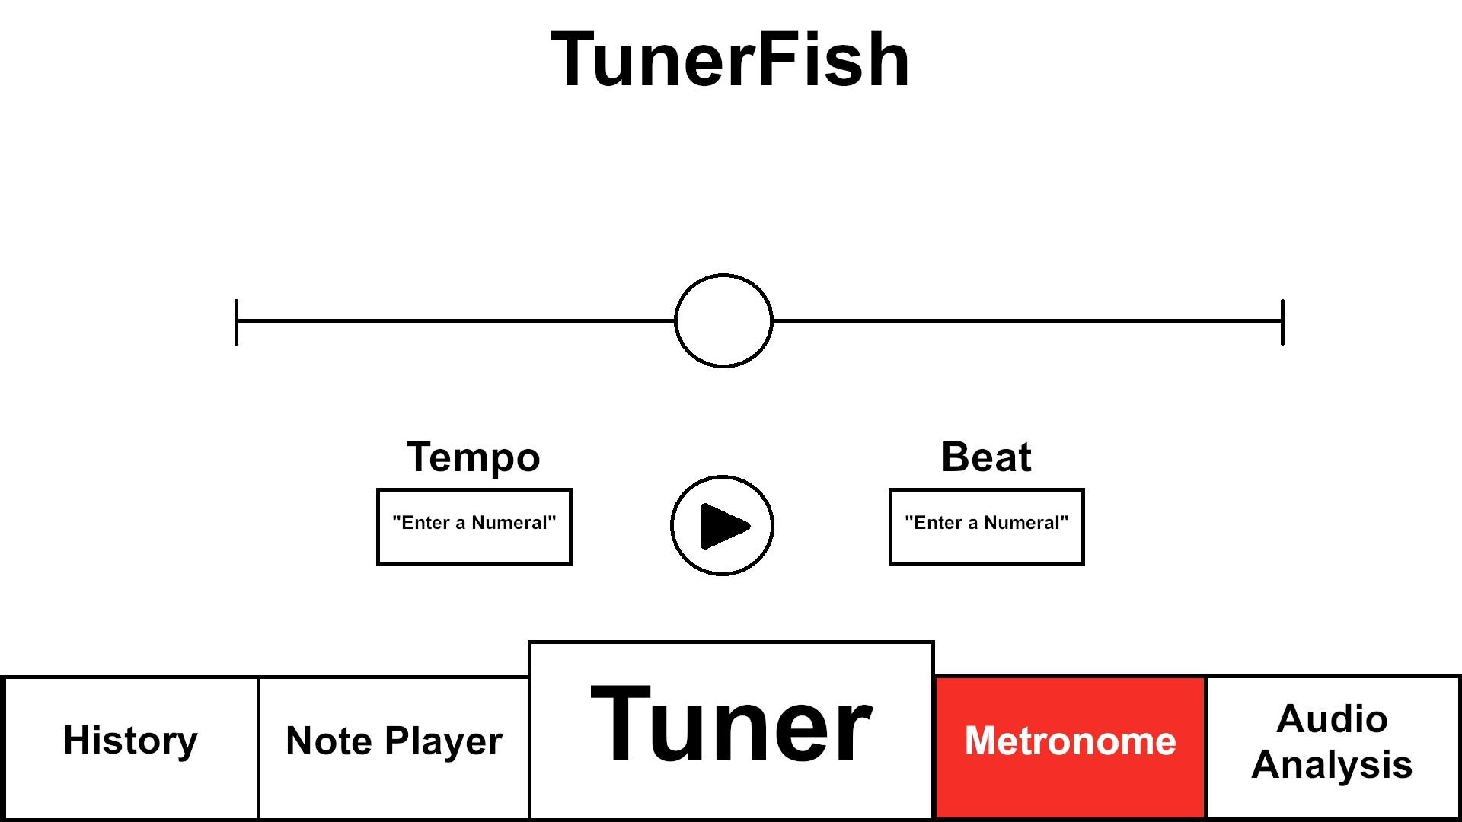

Slide 10
Audio Analysis feature
Inherited from Note class
AudioAnalysis class:
properties:
noteDetected: bool
closestNote: Note
freeze: bool
Methods:
ClearFrozen(): void

Slide 11
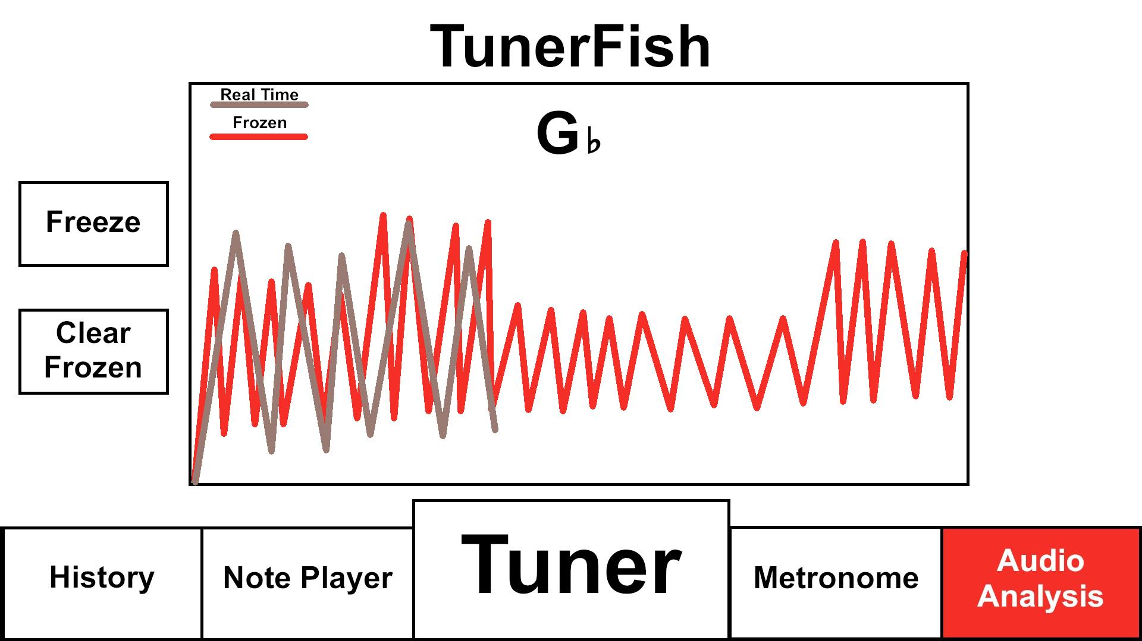

Slide 12
Note Player Feature
Inherited from Note class
NotePlayer class:
Properties:
note: List<Note>
beingSustained: bool
beingPlayed: bool
Methods:
sustained(beingSustained): void
play(beingPlayed): void

Slide 13
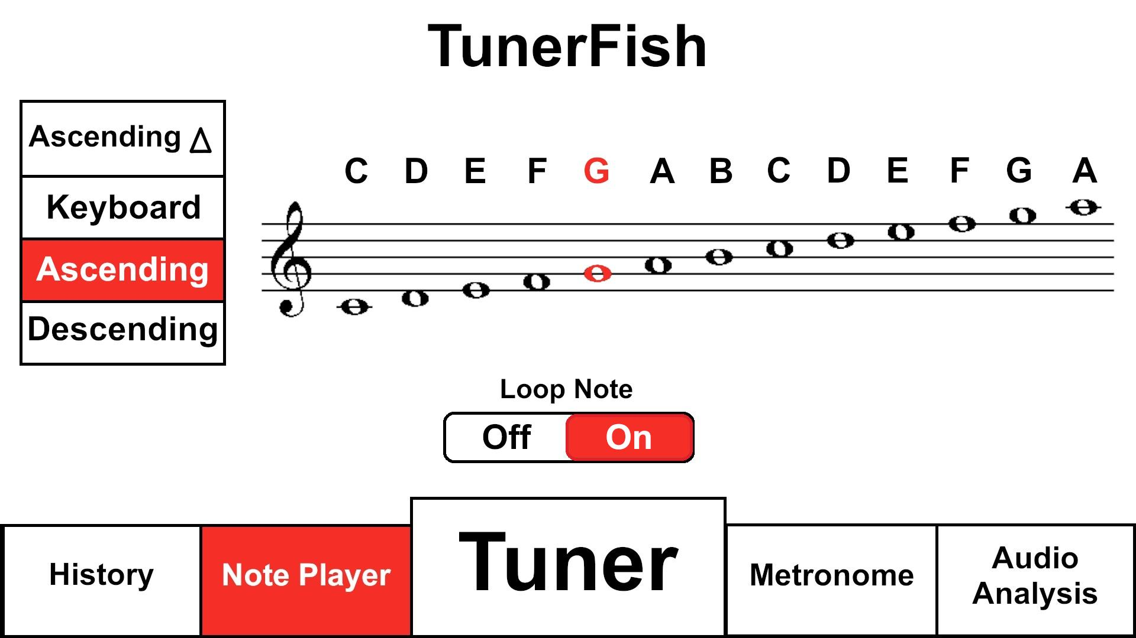

Slide 14
History feature
Have history and Event classes

Slide 15
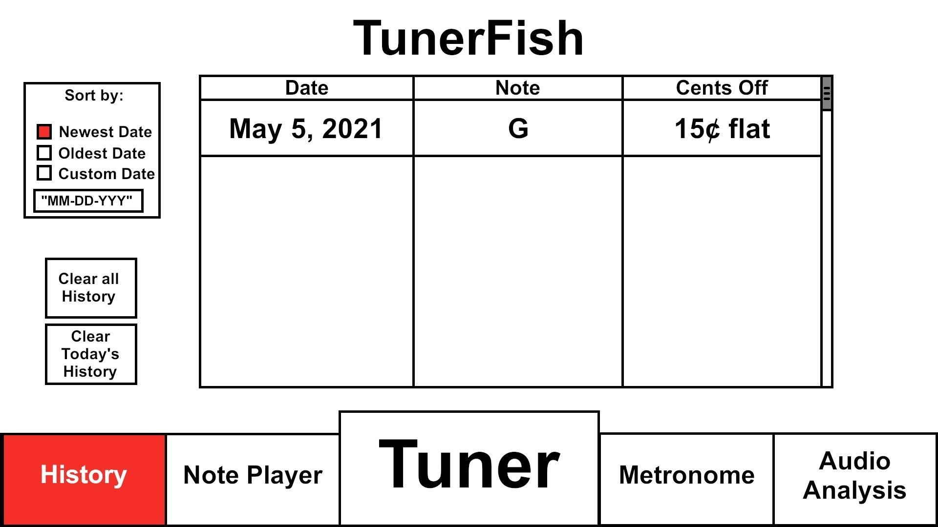

Slide 16
Event Class
Inherited from Note class
properties:
date: DateTime
name: string
note: Note
tuning: int

Slide 17
History class
Properties:
Events: List<Event>
Methods:
DeleteEvent(event; Event): void
AddEvent(event; Event): void
Clear(): void

